Slide 1
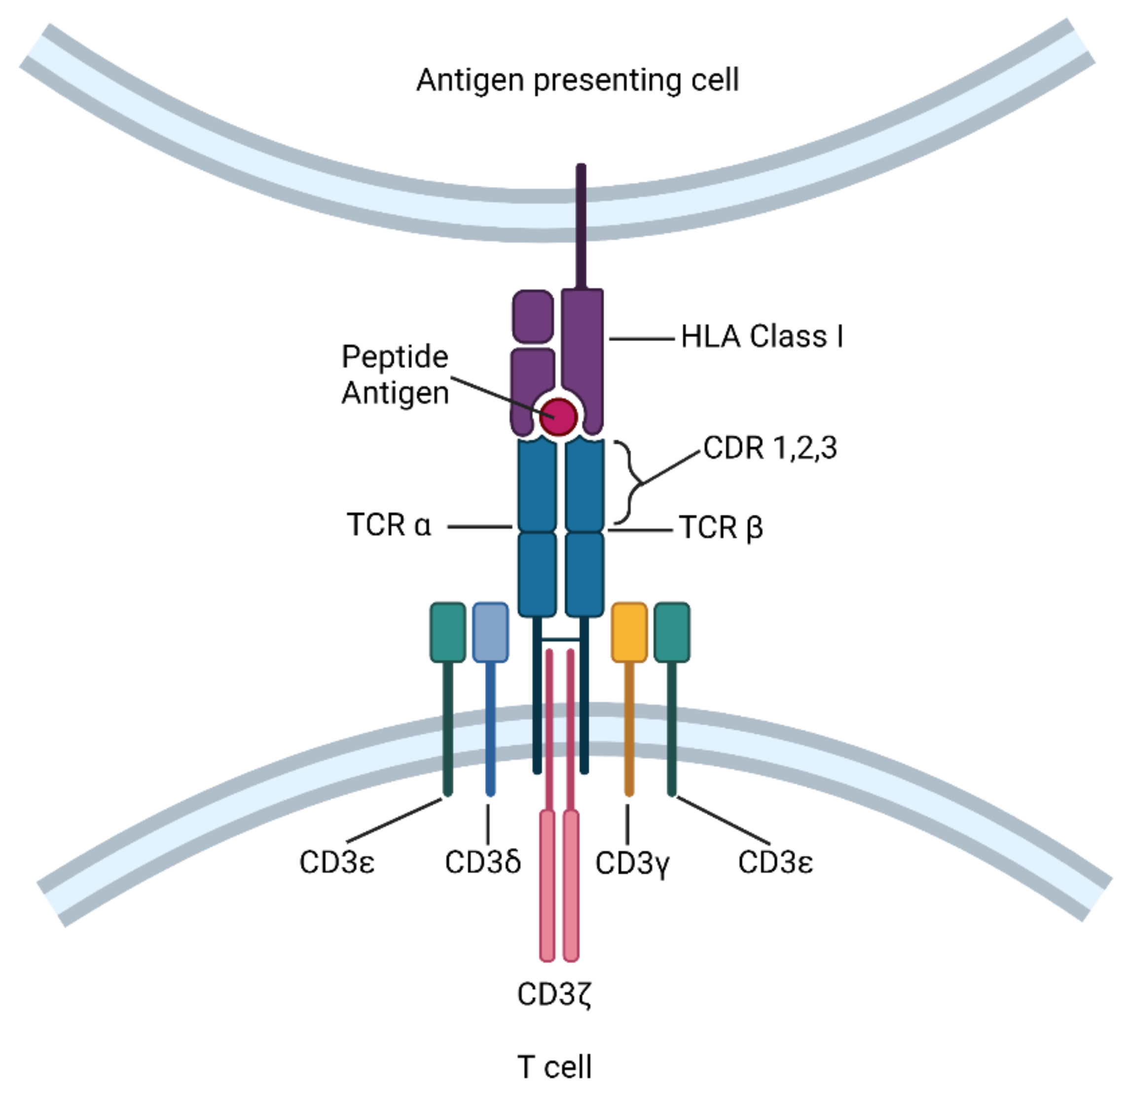
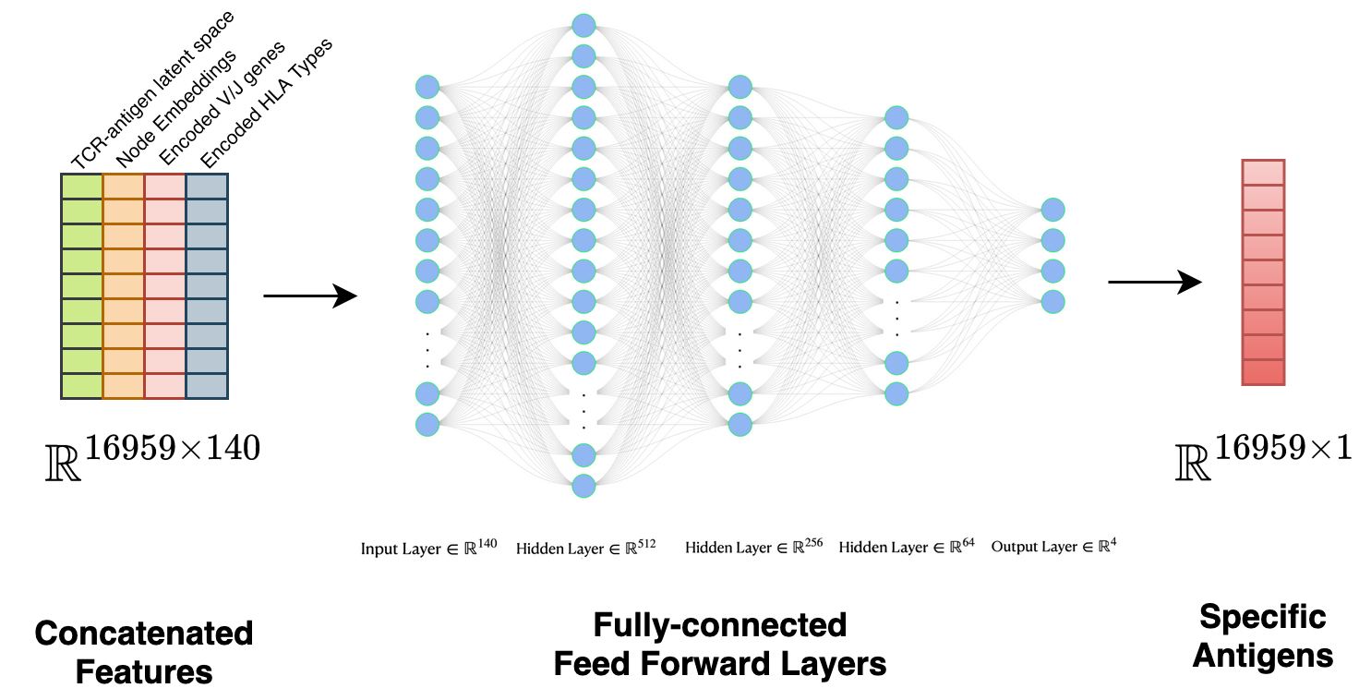
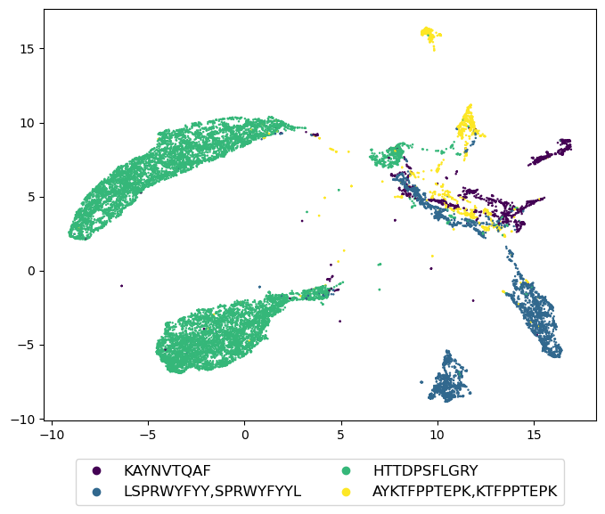
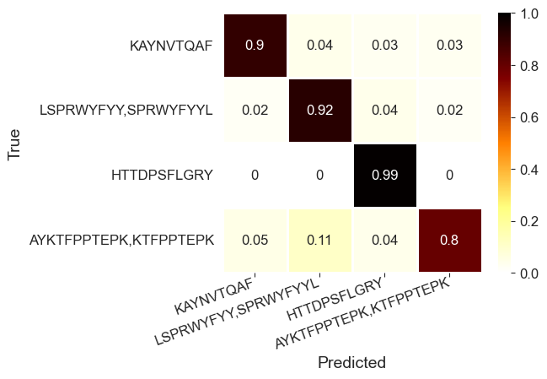
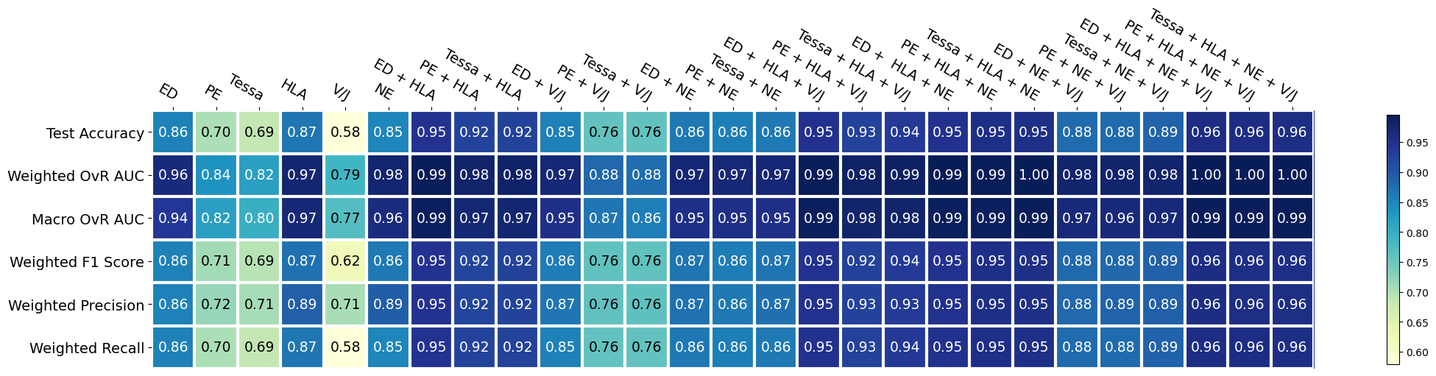
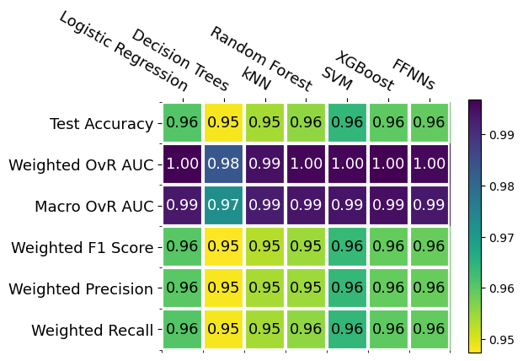
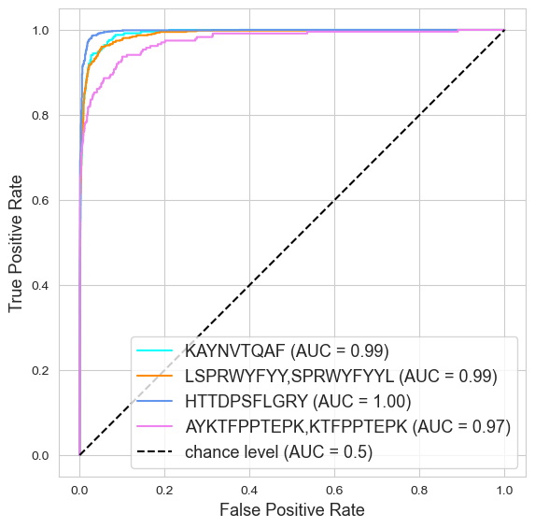
Prediction of Multi-Class Peptides by T-cell Receptor Sequences with Deep Learning
Leah Ung¹, Hai Yang², Phi Le¹, Anwen Huang^{1,3}, Tao He⁴, Li Zhang^{1,2,5}
¹Department of Medicine, University of California, San Francisco, San Francisco, USA; ²Helen Diller Family Comprehensive Cancer Center, University of California, San Francisco, San Francisco, USA; ³University of California, Berkeley, Berkeley, USA;
⁴Department of Mathematics, San Francisco State University, San Francisco, USA; ⁵Department of Epidemiology & Biostatistics, University of California San Francisco, San Francisco, USA.
BACKGROUND
METHODS
CONCLUSIONS
T cells recognize foreign antigens as peptides attached to human leukocyte antigen Class I molecules (HLA-I) through T cell receptors (TCR)
Once a foreign antigen is recognized, the body triggers an immune response to defend against invaders
A successful binding is determined by Peptide-MHC complex and TCR
The complementary-determining region 3 (CDR3) of TCR b chain is responsible for recognizing peptides
T-cell Peptide Recognitionplag
Figure 1. Workflow of Feature Engineering Tasks
Atchley Factor Vectorization Task
Atchley factors along with a maximal sequence length and zero padding are used to vectorize TCR and antigen sequences. (Atchley 2005)
Sequence Embedding Module
An autoencoder is utilized to reduce noise, and produces a fixed-length latent space vector.
A proposed encoder-decoder model is used to train information from both TCR and peptide sequences.
The TCR latent space from the TCR autoencoder is used as input for the encoder, while the peptide latent space from the peptide autoencoder is used as output for the decoder.
The hidden layer of the last encoder block contains sequence embeddings that will be used for downstream prediction tasks.
Graph Embedding Module
NAIR is used to build an undirected graph of TCR similarity network (Yang 2023).
Each node in the network represents a TCR sequence in the dataset.
An edge is created between two nodes if their similarity measured by Levenshtein distance is less than 1.
Semi-supervised GraphSage is utilized to generate fixed-length numerical representations of the nodes using the graph structure of TCR similarity network and TCR-peptide latent space as node features. (Hamilton 2017)
Prediction Model - Feed Forward Neural Networks
All embedded features are concatenated and fed into a feedforward neural network with three fully connected layers. Cross-entropy is applied at the output to generate predicted probabilities associated with each peptide class.
Categorical Encoding Module
The binary encoder first encodes raw categories into ordinal categories, and then converts them into binary bitstrings.
These bitstrings are then broken down into binary digits, which are used to create multiple columns.
General patterns observed across all models are:
Scenarios with HLA Types or ED Atchley Factors tend to perform better.
Scenarios with more inputs included tend to perform better.
The highest test accuracy across all models is 0.96.
Both FFNNs and traditional ML perform very well, but FFNNs take significantly less time to train.
FFNNs perform the best when using the most inputs.
Figure 2. (A) Network Similarity Graph of TCR sequences; (B) UMAP Plot of TCR Nodes Embedded by GraphSage with Antigen Labels
REFERENCES
A
Hamilton, Will, Zhitao Ying, and Jure Leskovec. "Inductive representation learning on large graphs." Advances in neural information processing systems 30 (2017).
Atchley, William R., et al. "Solving the protein sequence metric problem." Proceedings of the National Academy of Sciences 102.18 (2005): 6395-6400.
Yang, Hai, et al. "NAIR: Network Analysis of Immune Repertoire." Frontiers in Immunology 14 (2023): 1181825.
Nolan, Sean, et al. "A large-scale database of T-cell receptor beta (TCRβ) sequences and binding associations from natural and synthetic exposure to SARS-CoV-2." Research square (2020).
https://www.mdpi.com/2073-4409/10/9/2379
https://www.mdpi.com/2073-4409/10/9/2379
OBJECTIVE
We propose a two-step pipeline for predicting TCR-peptide binding:
Step 1 involves building a feature engineering process that consists of 3 parts: Sequence Embedding Module, Graph Embedding Module, and Categorical Encoding Module.
Step 2 involves building a prediction model that identifies the specific antigen to which a TCR will bind.
This study emphasizes the importance of using an advanced sequence embedding model to improve TCR-peptide binding prediction performance.
ACKNOWLEDGEMENTS
B
DATASET
Figure 4. Evaluation of FFNNs: (A) Confusion Matrix Normalized by True; (B) OvR ROC Curves
We used Adaptive Technologies’ MIRA dataset, which records TCR-peptide binding and features like the TCR nucleotide sequence, peptide amino acid sequence, V/J genes and HLA Types. (Nolan 2020)
A
RESULTS
Figure 3. (A) Heatmap Comparing Performance of FFNNs on Various Feature Inputs; (B) Heatmap Comparing Performance of Various Models on Concatenated Features
A
B
B
Corresponding author: li.zhang@ucsf.edu

